Slide 1

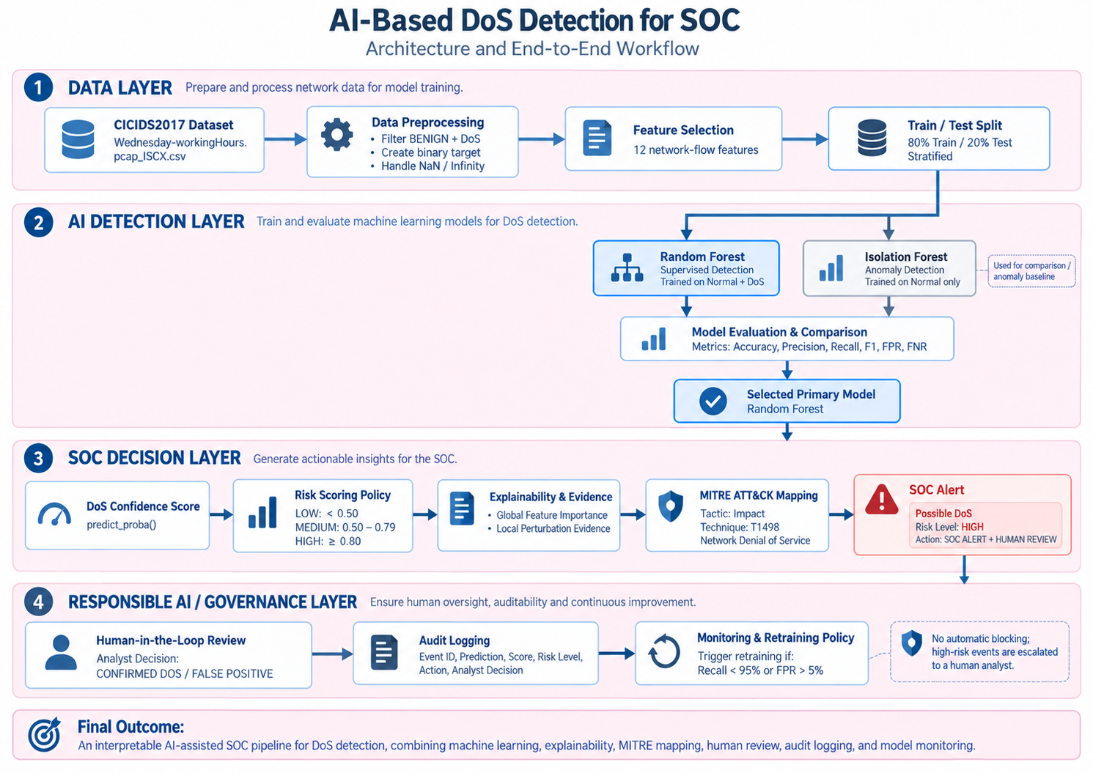
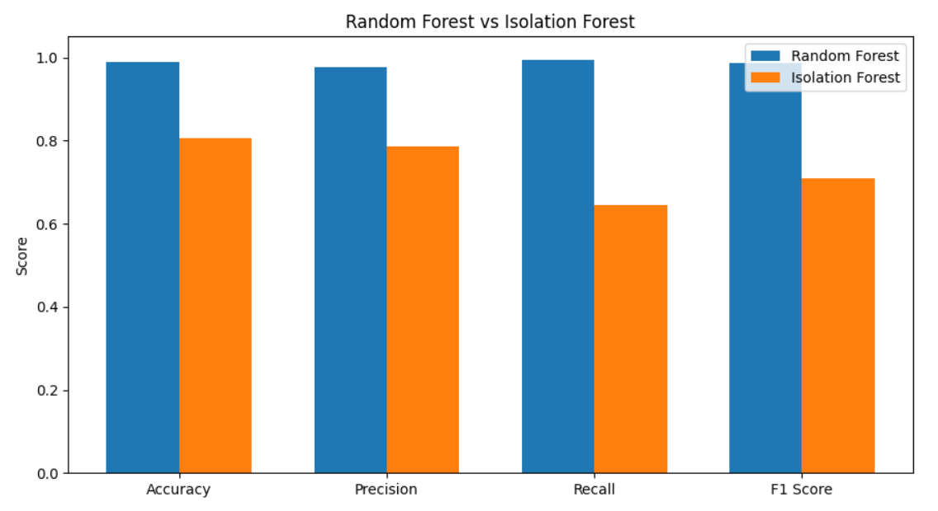
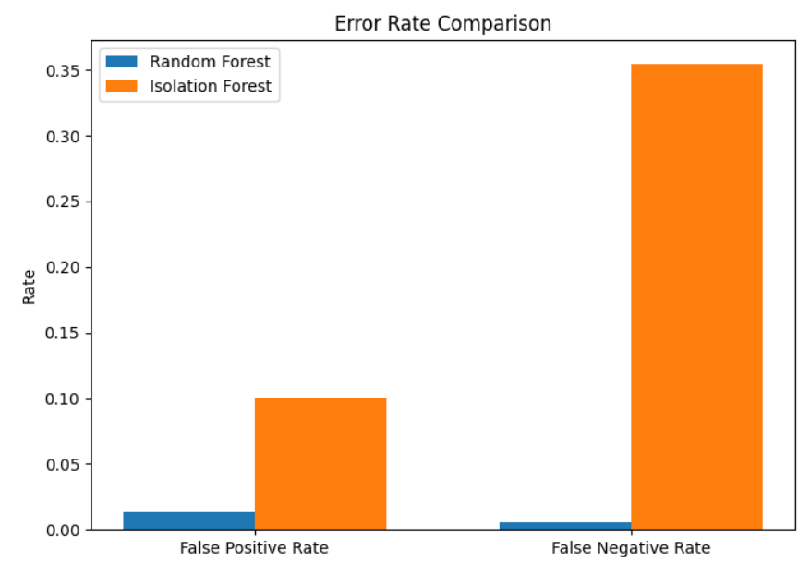
AI Enhanced Cybersecurity | AI Based DoS Detection for SOC Noga Menahem, Hen Golyan 2026, Summer semester – שנת תשפ"ז, סמסטר קיץ
Andrei KoJukhov
Introduction
This project develops an AI-assisted SOC pipeline for detecting DoS attacks using machine learning. Random Forest and Isolation Forest were compared, and the selected model was integrated with risk scoring, explainability, MITRE ATT&CK mapping, human review, logging, and monitoring.
Methodology & System Architecture
Dataset: CICIDS2017 - Wednesday Working Hours
Task: Binary classification - Normal vs. DoS
Models: Random Forest and Isolation Forest
Train/Test Split: 80/20 stratified
Selected Features: 12 network flow features
Source Code / Project Repository
GitHub Repository
Notebook + SOC log + source files
Results
Random Forest achieved consistently better performance, with 98.96% Accuracy and 99.45% Recall, and was selected as the primary DoS detection model.
Conclusions
• Random Forest significantly outperformed Isolation Forest.
• The final pipeline provides risk scoring, explainability and MITRE ATT&CK context.
• Human review prevents fully automated security decisions.
Discussions / Future Work
• Evaluate the model on additional and real-time network traffic.
• Extend the system with additional attack categories, drift monitoring and SIEM integration.

